Slide 1

Meet the Staff
2025-2026
Blackfriars Primary School

Slide 2
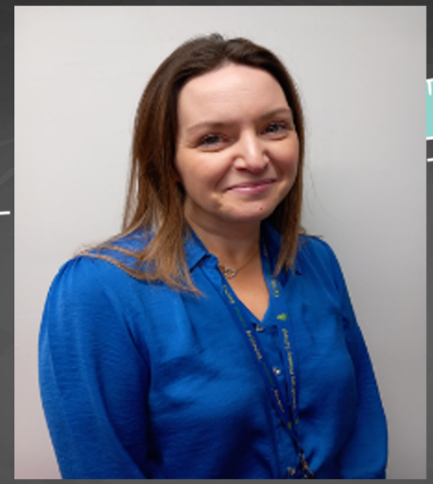
Head Teacher
Ms Laura Crossan

Slide 3
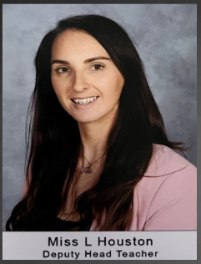
Depute Head Depute Head
Miss Laura Houston Mrs Jac MacGregor

Slide 4
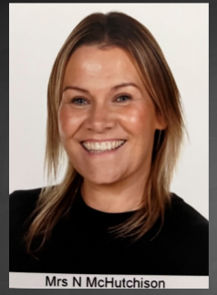
Mrs McHutchison Mrs Saeed
Principal Teacher Principal Teacher & P6

Slide 5
Primary 1M Primary 1G
Mrs McHutchison Mrs Gillespie
& Ms McCauley (0.2)

Slide 6
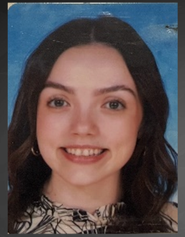
Primary 2 Primary 3/2
Mrs Gallacher Miss Cox

Slide 7
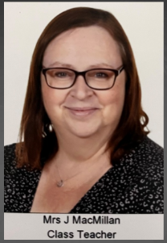
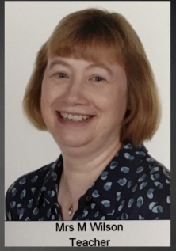
Primary 3 Primary 4/3
Mrs Macmillan Mrs Veitch & Mrs Wilson

Slide 8
Primary 4 Primary 5/4
Miss Pollock Ms Ritchie

Slide 9
Primary 5 Primary 6/5
Mr Gilchrist Mr Jones

Slide 10
Primary 6 Primary 7L
Miss O’Raw & Mrs Saeed (0.3) Miss Love

Slide 11
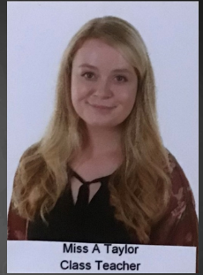
Primary 7T
Miss Taylor

Slide 12
Nurture Teacher Nurture Assistant
Miss Benzie Ms Lamont

Slide 13
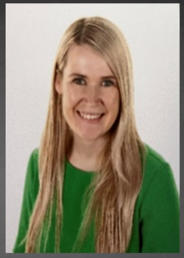
EAL Teacher EAL Teacher
Miss Bone Miss McNamee

Slide 14
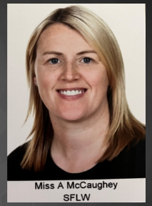
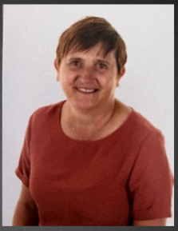
SfLW SfLW
Miss McCaughey Miss Williamson

Slide 15
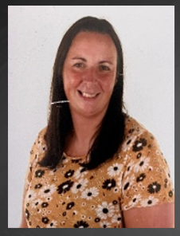
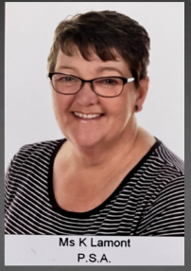
SfLW SfLW
Mrs Gilchrist Ms Lamont

Slide 16
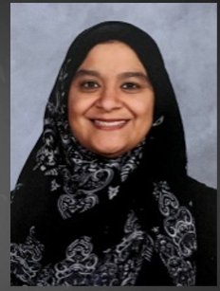
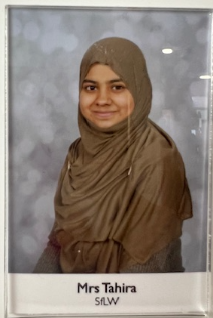
SfLW SfLW
Mrs Zafar Mrs Tahir

Slide 17
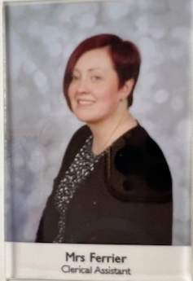
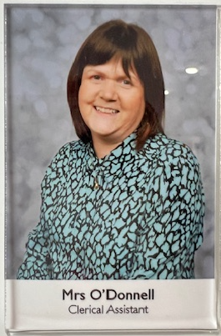
Clerical Assistant Clerical Assistant
Mrs O’Donnell Mrs Ferrier

Slide 18
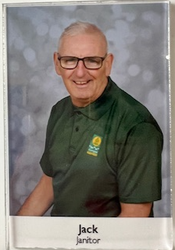
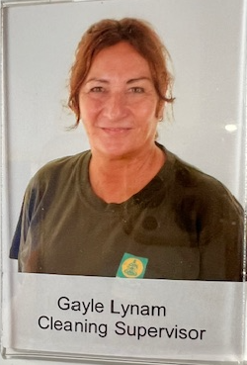
Jack the Janitor Cleaning Supervisor
Gayle Lynam

