Slide 1
Welcome to Blackfriars Nurture Room
The Rainforest Room

Slide 2
Why Nurture Rooms are Important
For some children, being a member of a large class in school can present difficulties. For a number of reasons, children may have difficulty settling in school.
Nurture groups are a short-term, focused intervention for children with particular social, emotional and behavioural difficulties which are creating a barrier to learning within a mainstream class.
It has been shown that some children can benefit from the support that a nurture room can offer. In Blackfriars this would be the Rainforest Room.

Slide 3
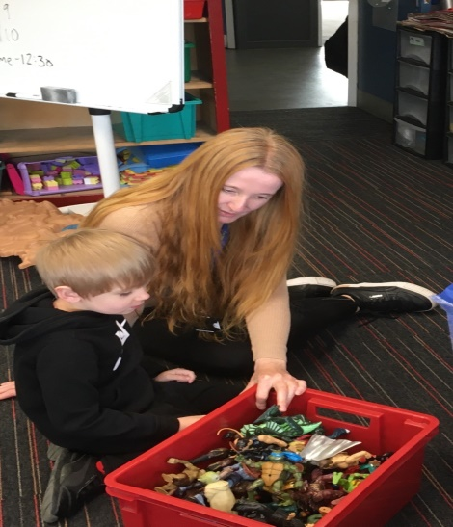
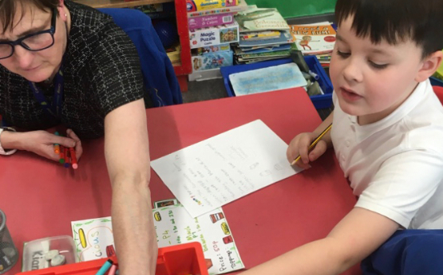
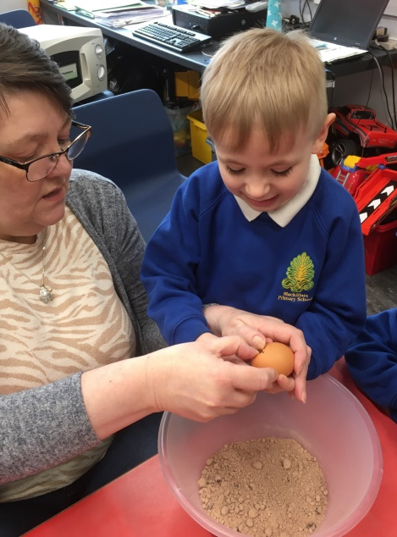
Meet our Nurture Staff
Nurture Training
All nurture staff undergo nurture training. The professional learning course is intended to support participants to both take forward nurture approaches at a whole school level and at a nurture group level.
The role of the nurture staff is to sustain nurturing relationships with the children who attend the groups.
They should be good role models, demonstrating appropriate and positive behaviour that is consistent and continuous.
They need to recognise that it is through a positive and affirming relationship that a child can perceive themselves as worthwhile.
Nurture Teacher: Ms Benzie
Nurture Assistants
Ms Lamont
Ms Williamson

Slide 4
Environment
The environment is designed to provide some of the supports a normal healthy home environment uses to provide nurturing experiences, in a mainstream setting, this includes:
Soft seating in an area of the room where informal activities can take place.
A food preparation area.
Age appropriate play, roleplay, drama, activities and games.
Worktables and chairs where the skills to work in a mainstream setting can be developed.

Slide 5
The Curriculum
Nurture rooms focus on providing stable daily routines and developmentally appropriate activities. The children benefit from a modified version of the school curriculum and take part in specially designed activities, which enhance social and emotional skills, improve their self-esteem and develop the skills necessary for learning – such as concentration and processing skills.
The curriculum features structured play and many practical experiences, with a great emphasis on emotional literacy, language development and communication.
Children remain an active part of their mainstream class, spend appropriate times within the nurture group according to their need and typically return to their class fulltime within two to four terms.
Activities
Breakfast.
Structured and free play.
Outdoor activities.
Enterprise initiatives.
Individual and group games including board games and puzzles.
Construction work.
Art/drama/music/massage.
Learning opportunities focused on language development and social/emotional and communication skills.
Literacy and numeracy are incorporated into the above the activities.

Slide 6
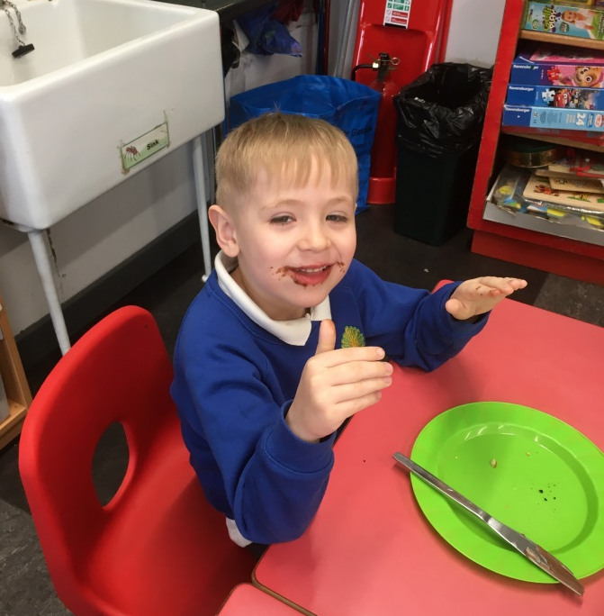
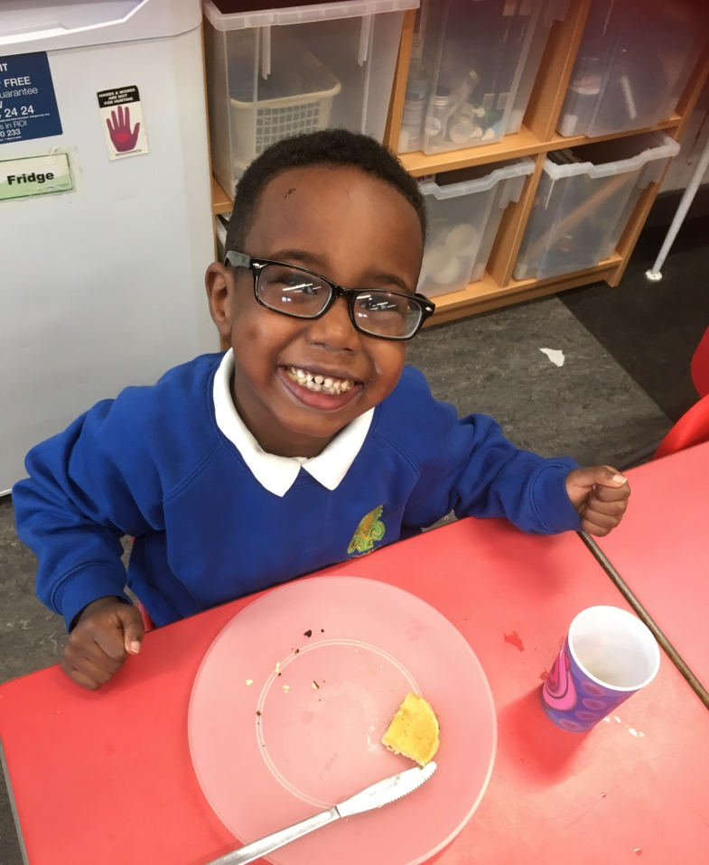
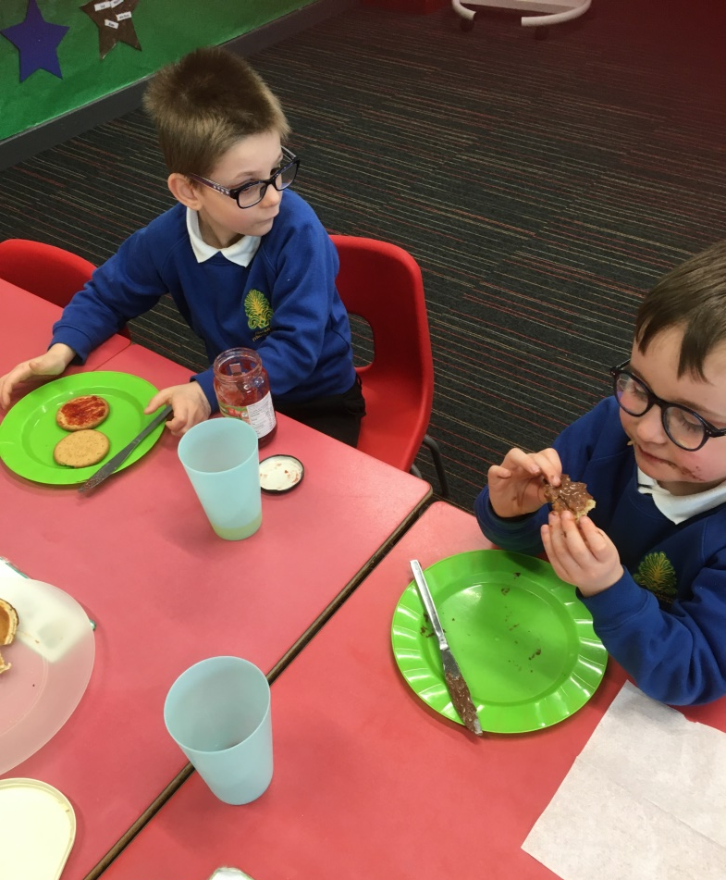
Enjoying Breakfast

Slide 7
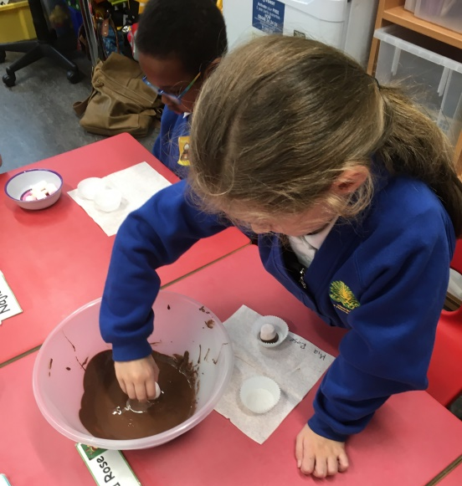
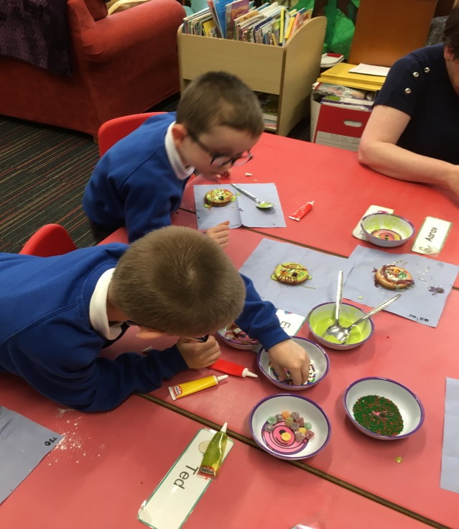
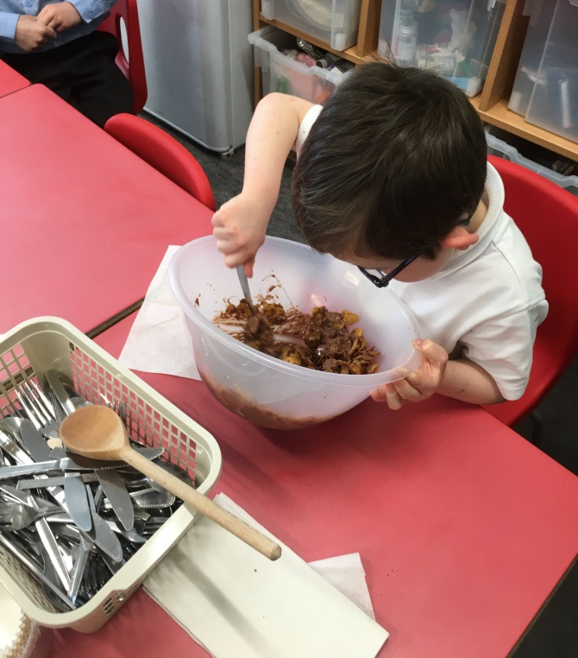
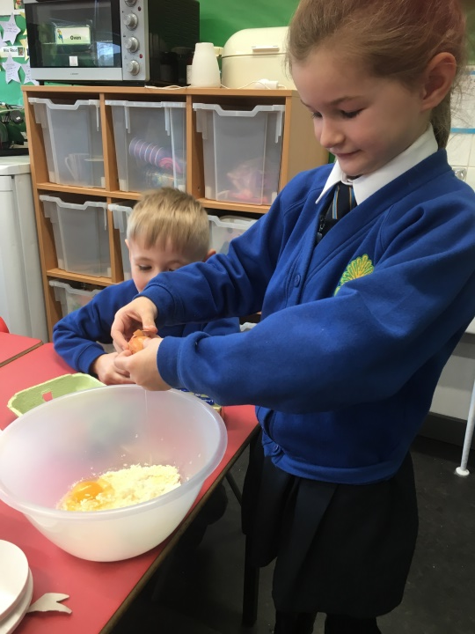
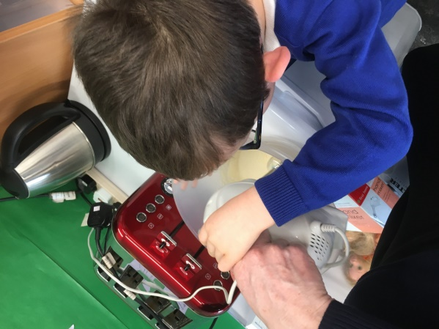
Cooking

Slide 8
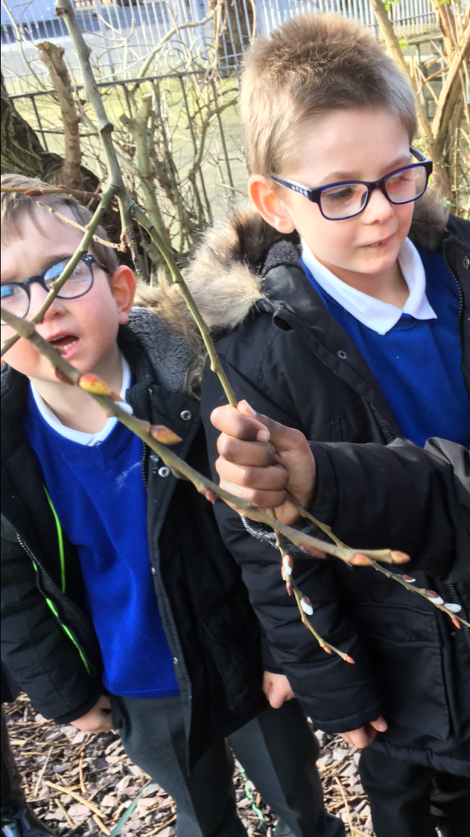
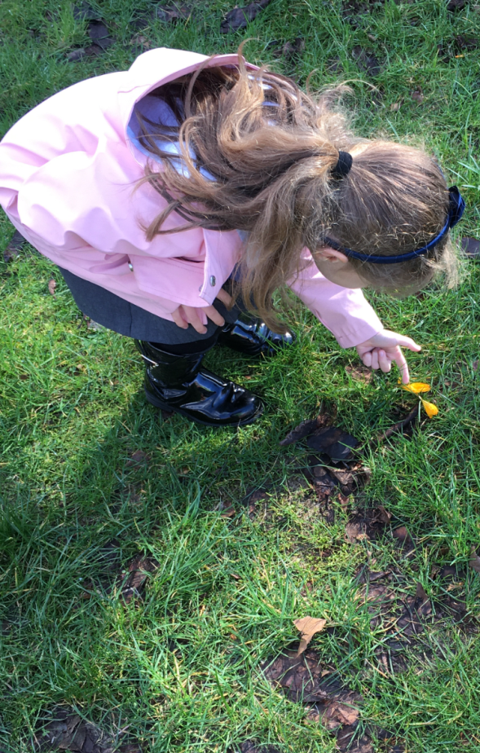
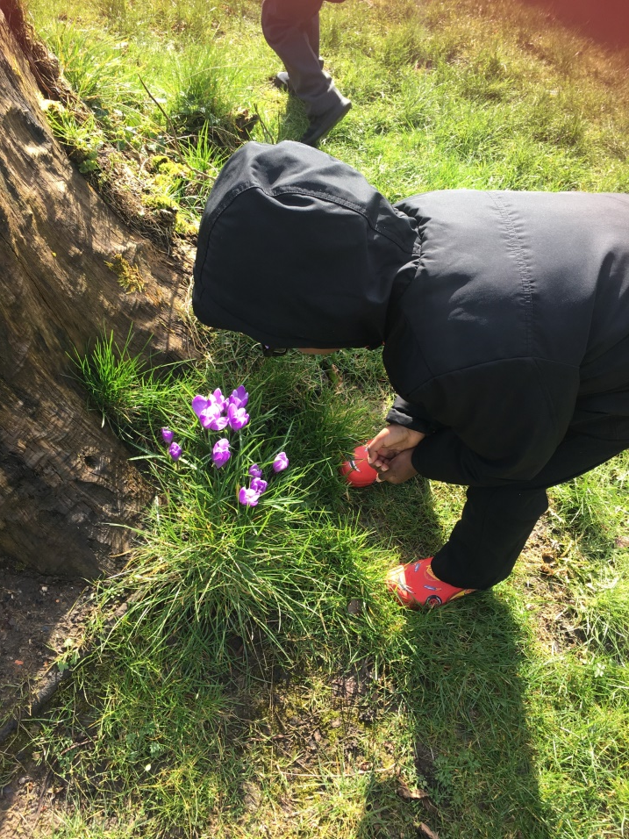
Outdoor Learning – Looking for signs of

Slide 9
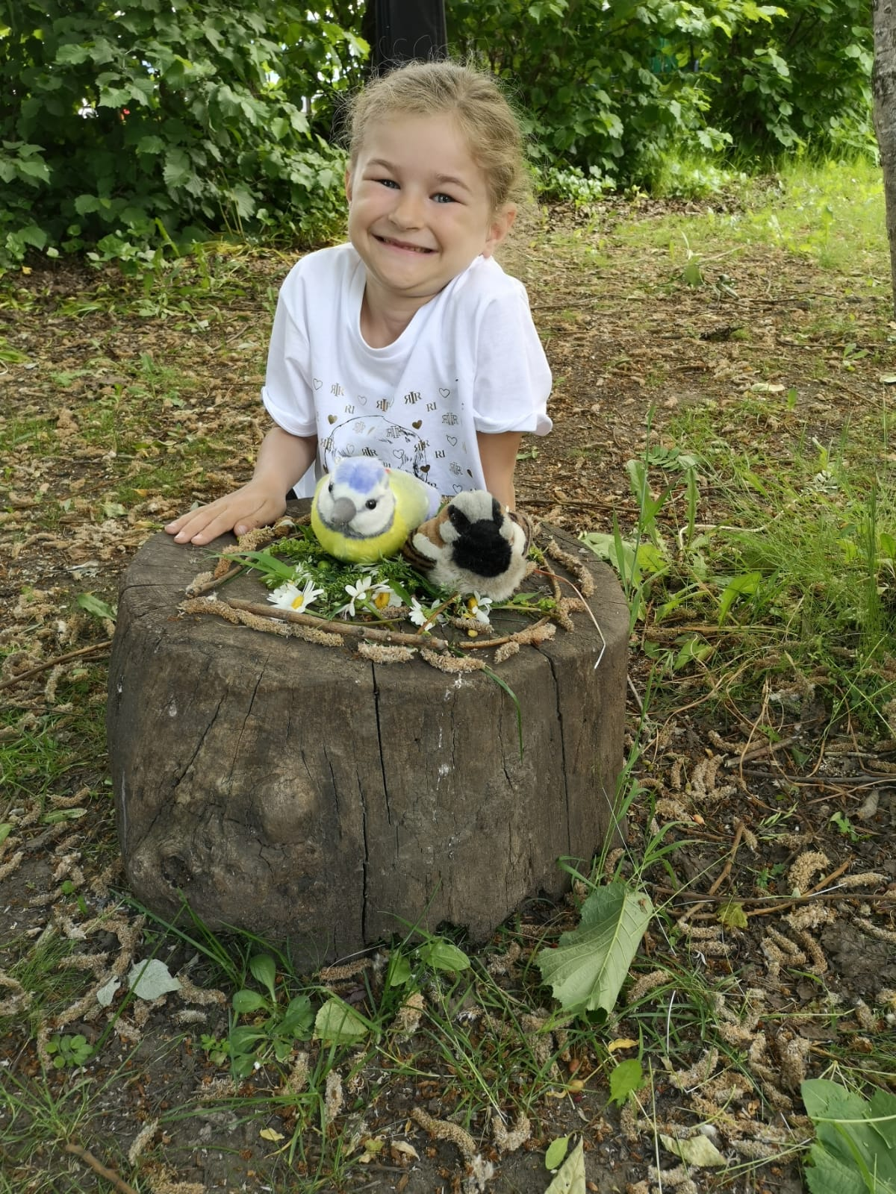
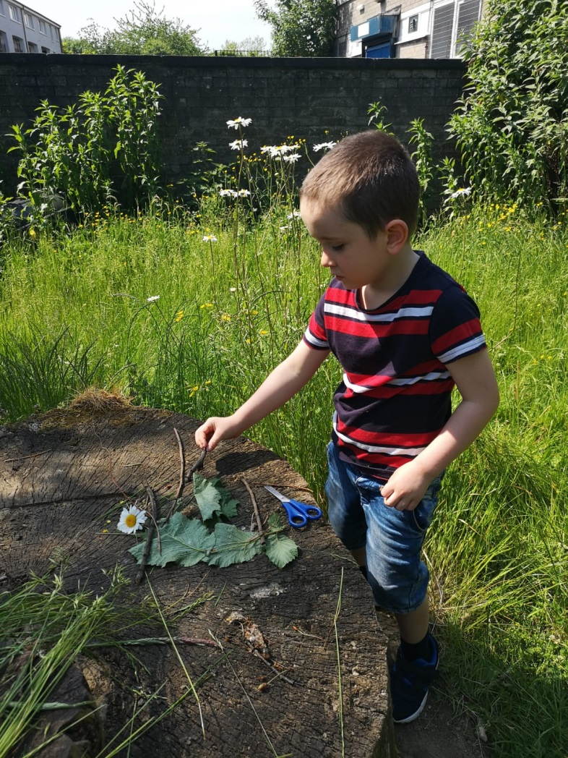
Outdoor Learning - Making Birds Nests

Slide 10
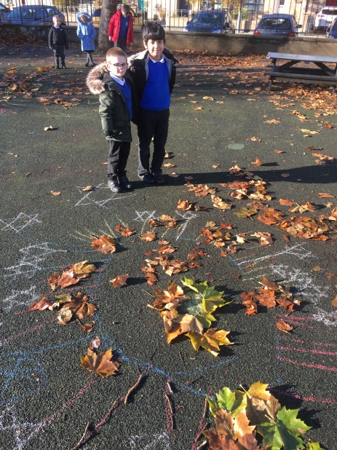
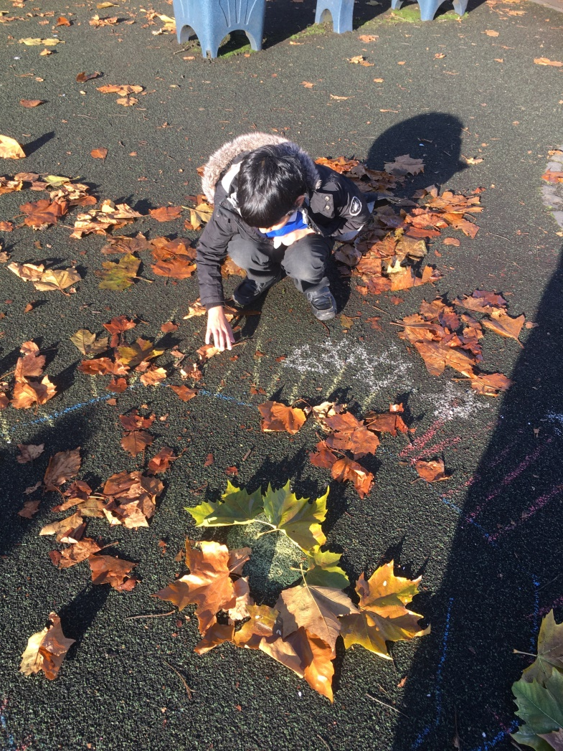
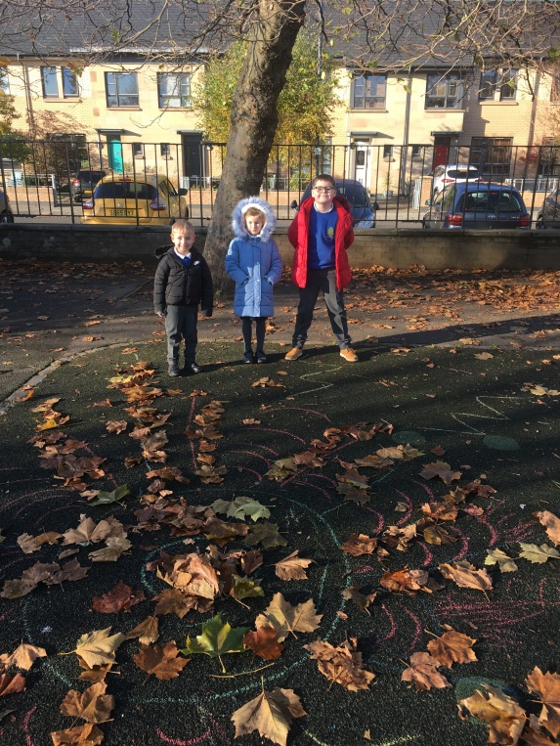
Outdoor Learning We used leaves and chalk to make fireworks

Slide 11
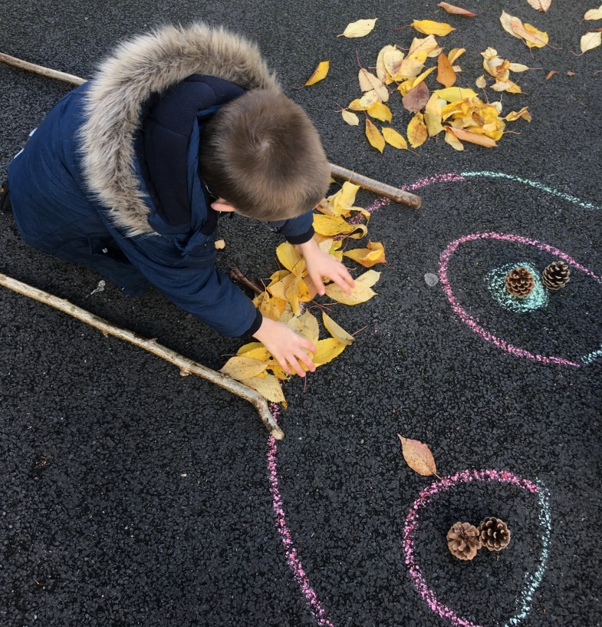
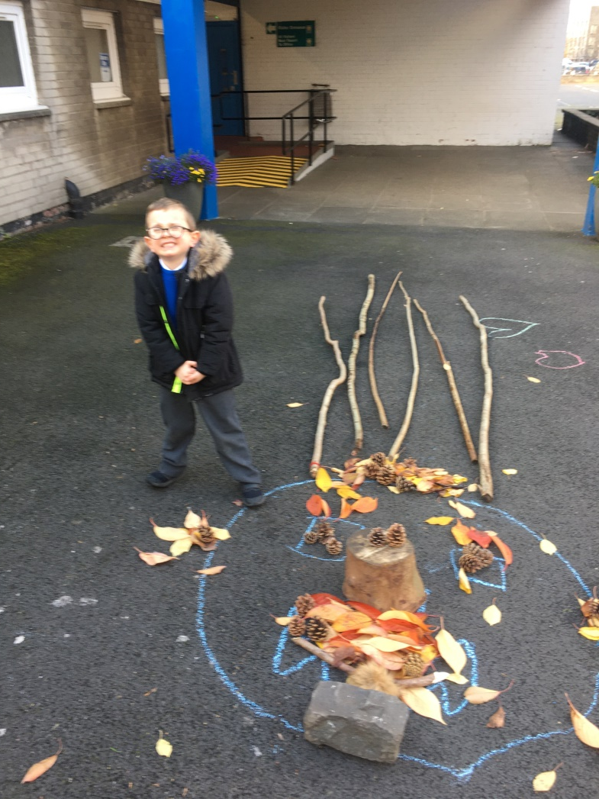
Outdoor Learning
For Halloween we made monsters using chalk, leaves and sticks

Slide 12
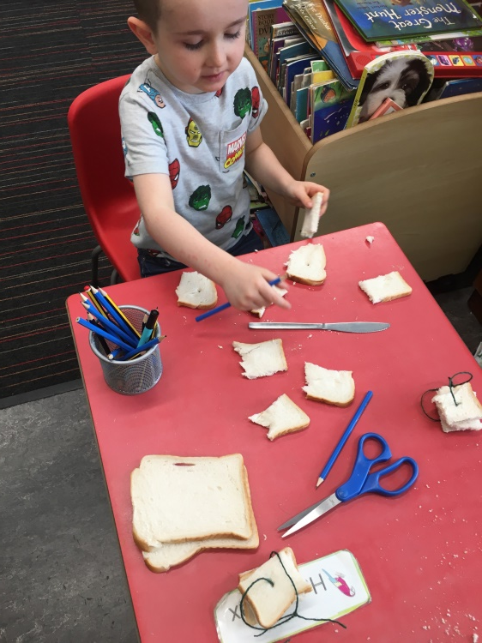
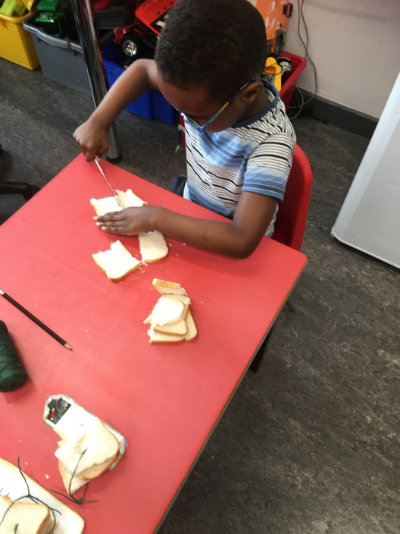
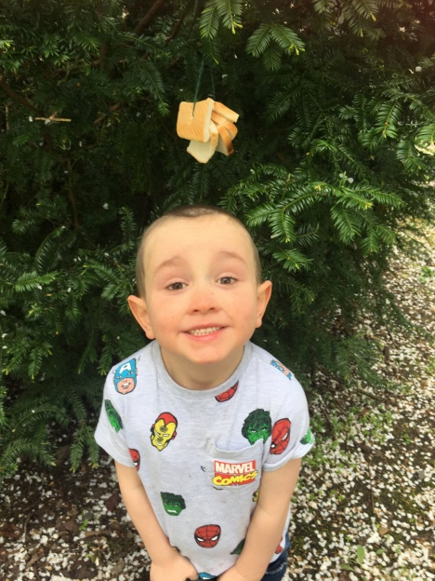
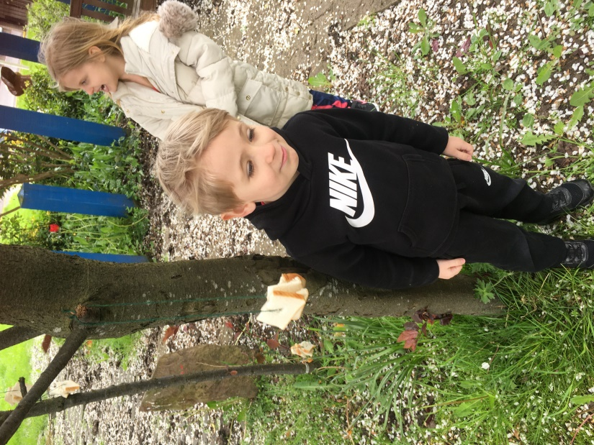
Outdoor Learning – Making Bird Feeders

Slide 13
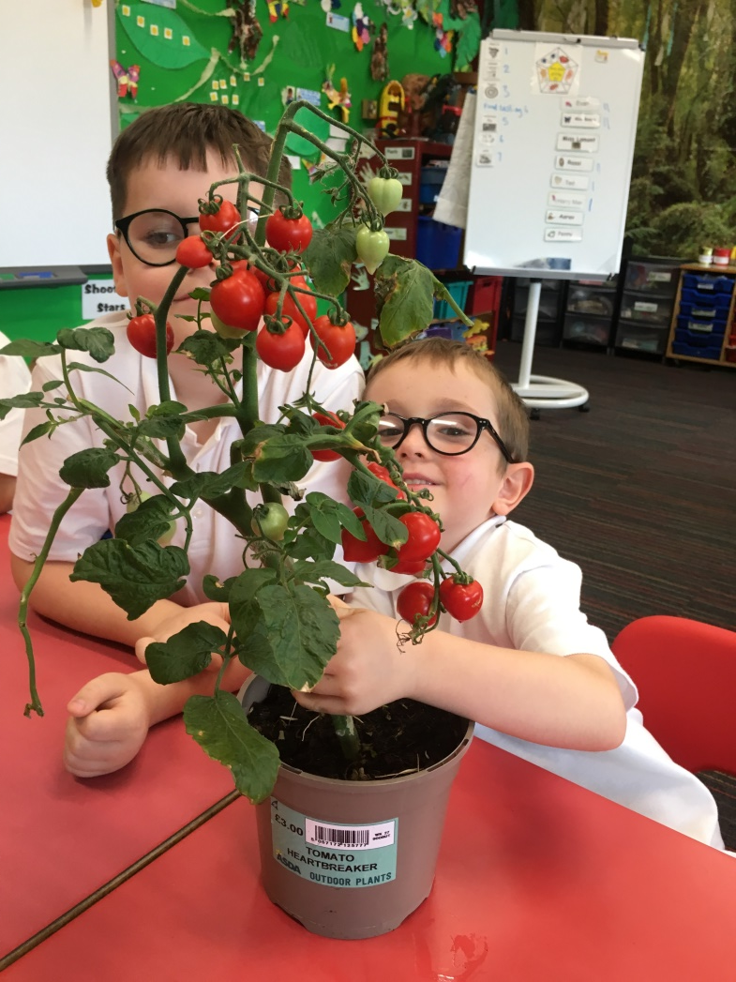
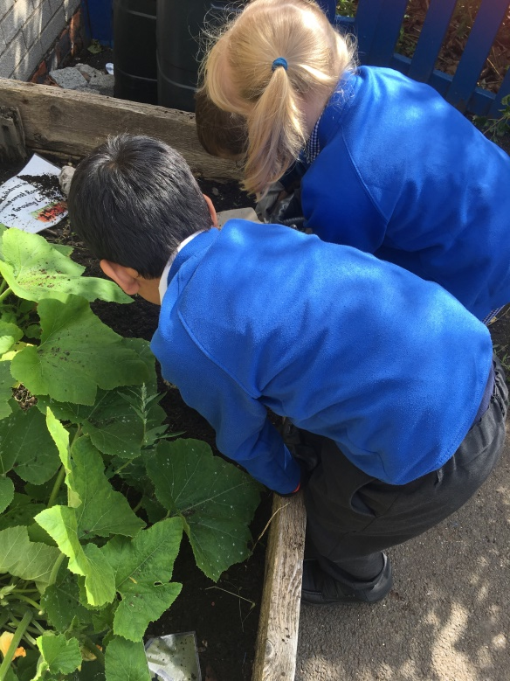
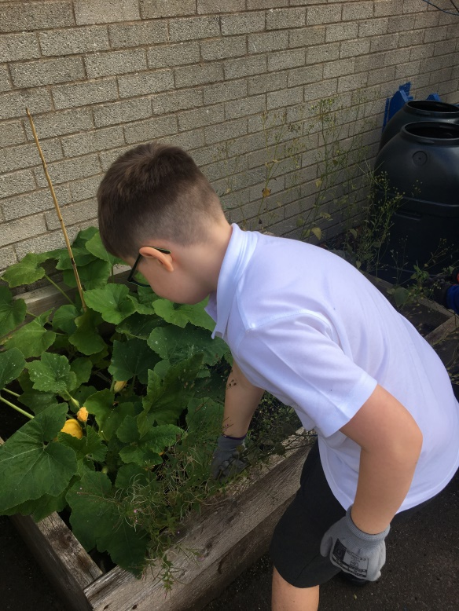
Outdoor and Indoor Gardening

Slide 14
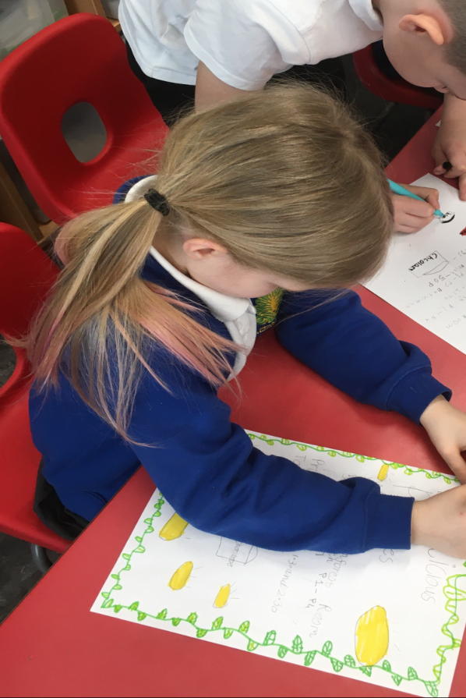
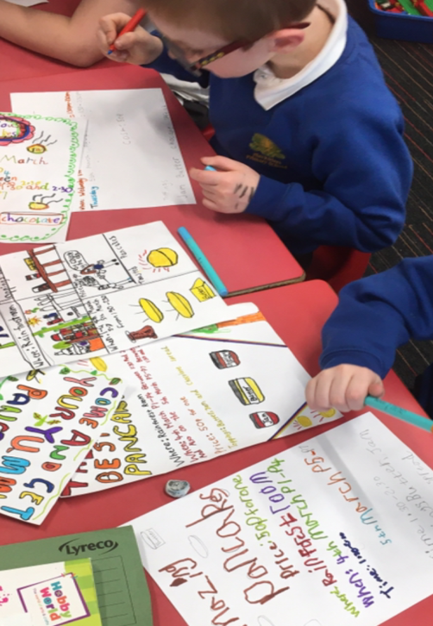
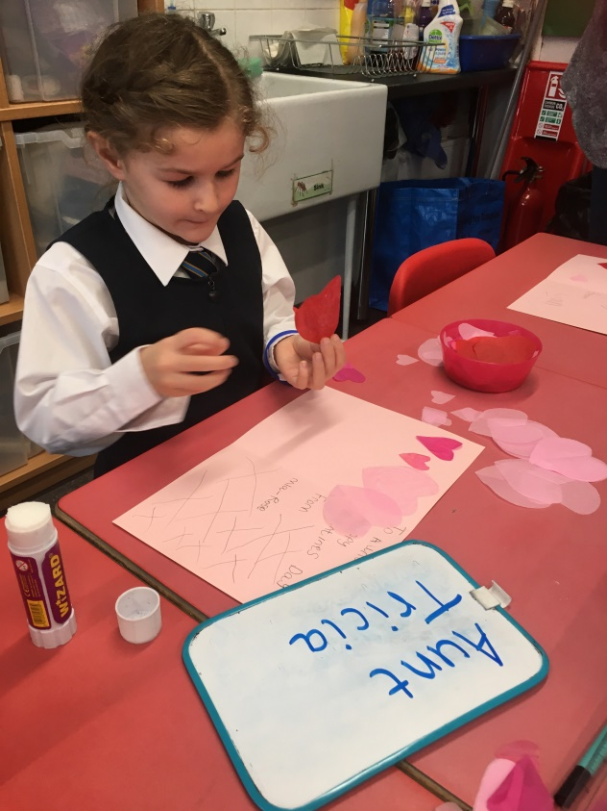
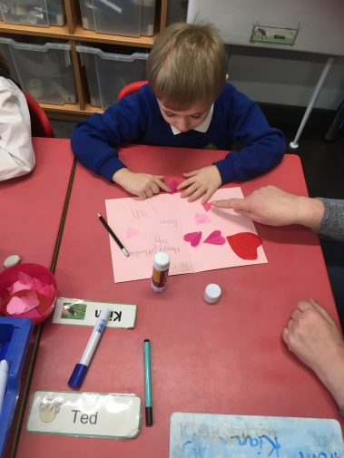
We develop our writing across curricular areas
Literacy

Slide 15
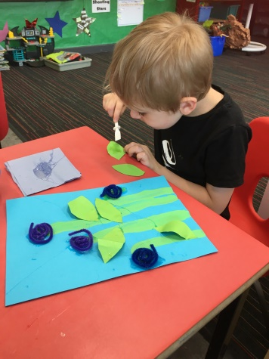
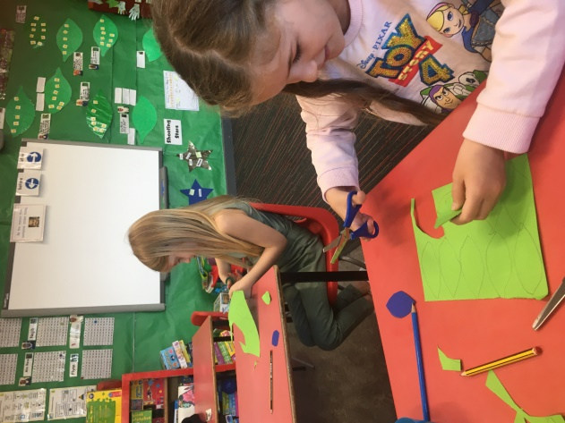
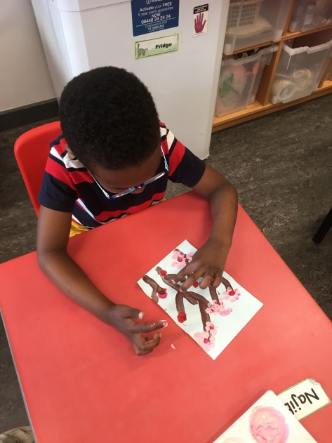
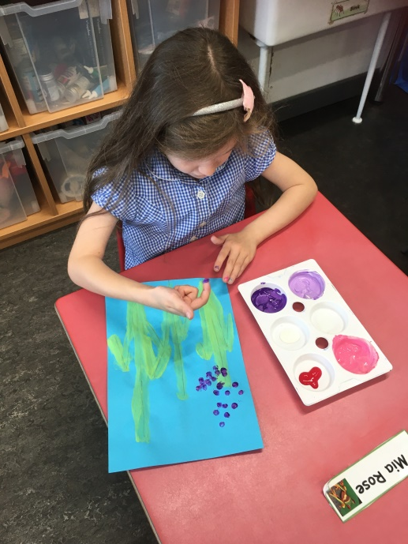
Creating Spring time pictures
Art
&
Crafts

Slide 16
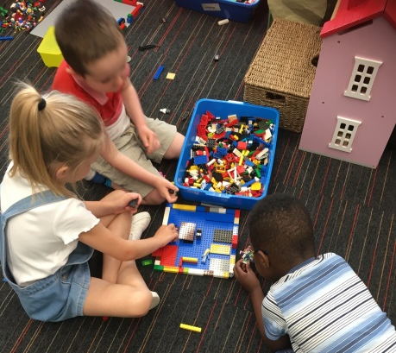
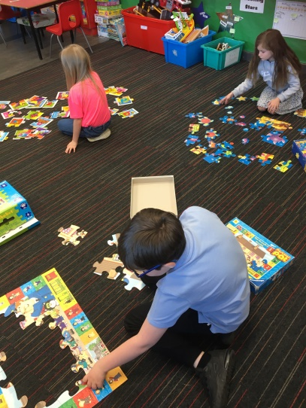
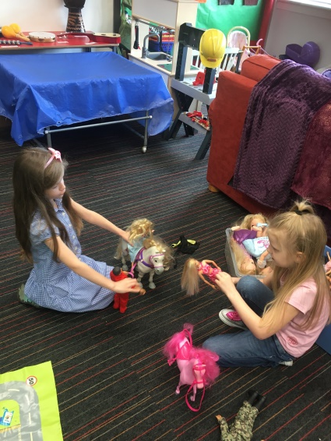
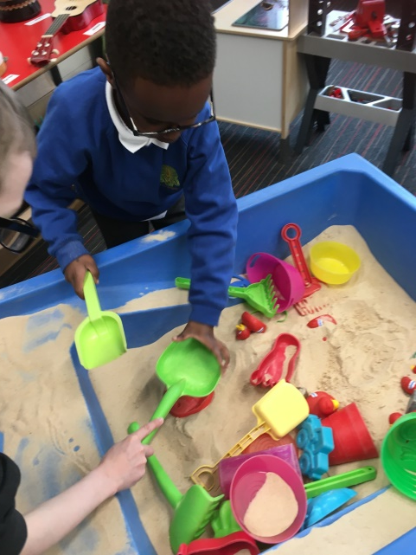
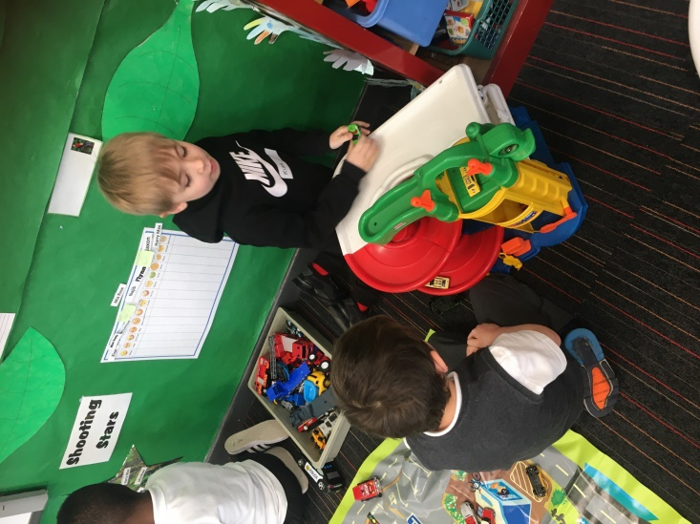
Learning through play

Slide 17
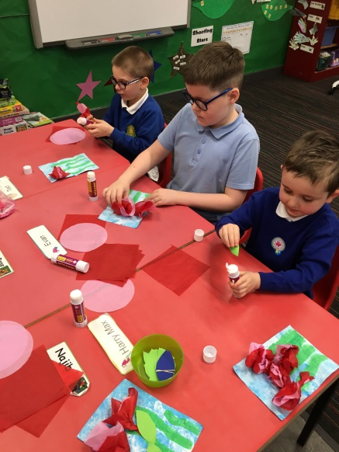
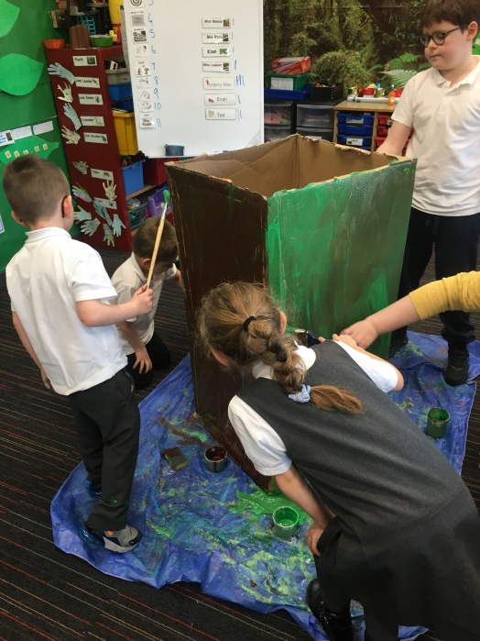
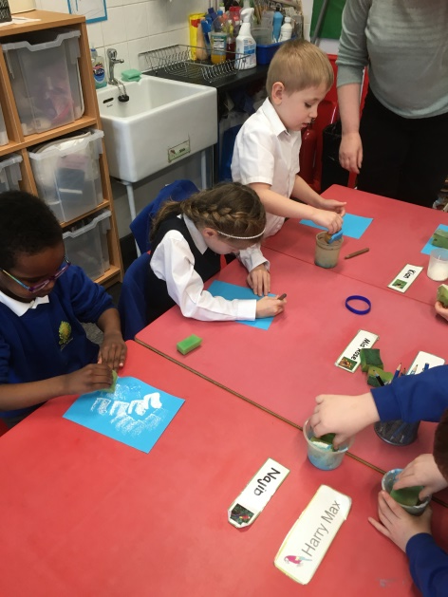
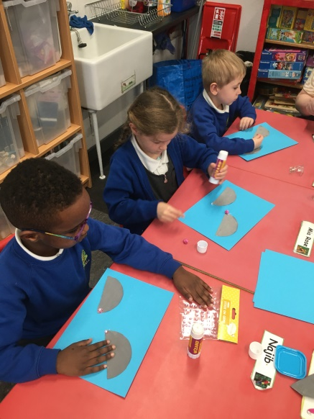
Art & Craft Activities

Slide 18
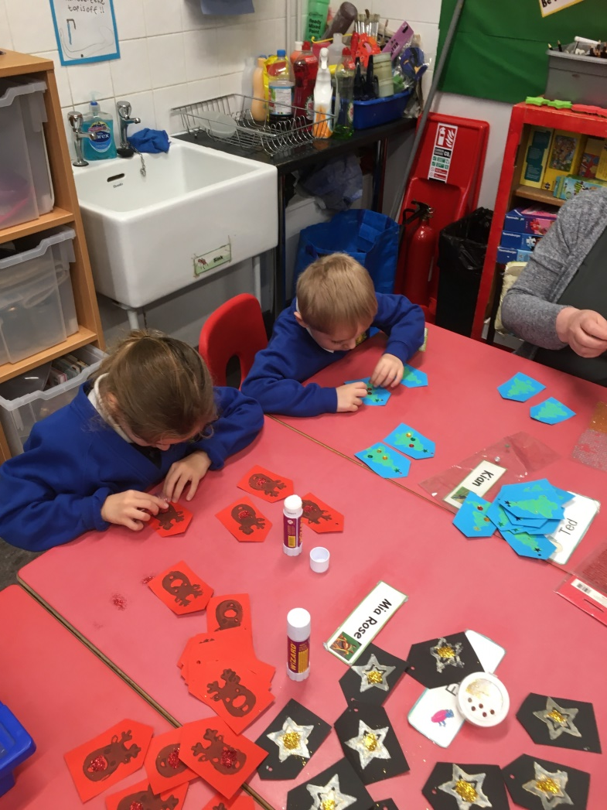
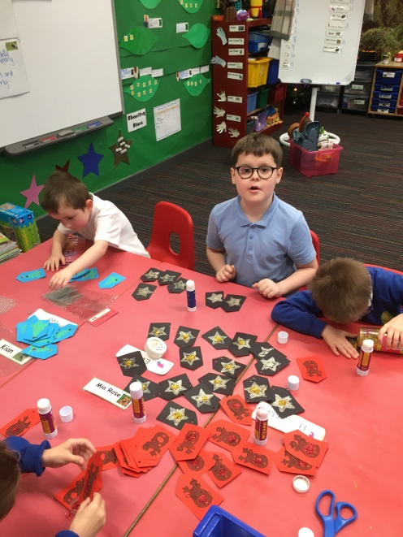
We Take Part in Enterprise Activities We sold tablet for the Christmas Fair

Slide 19
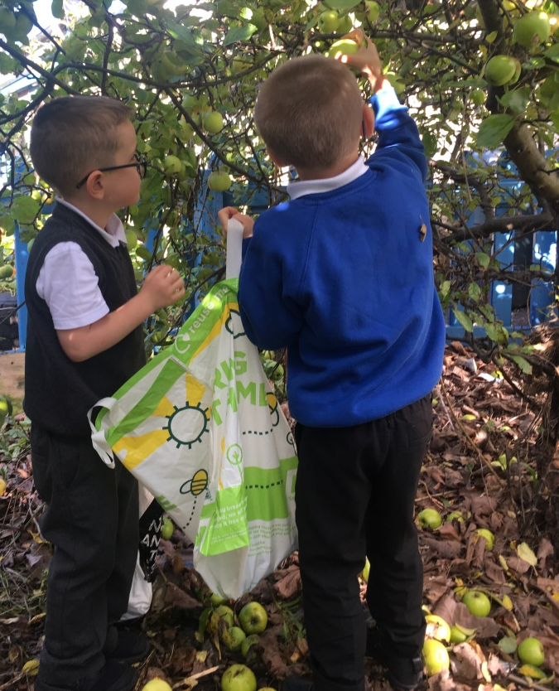
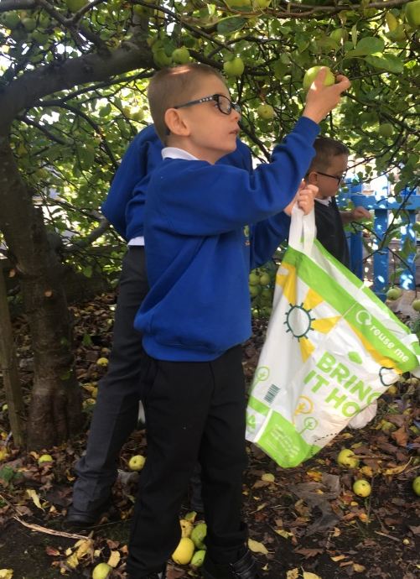
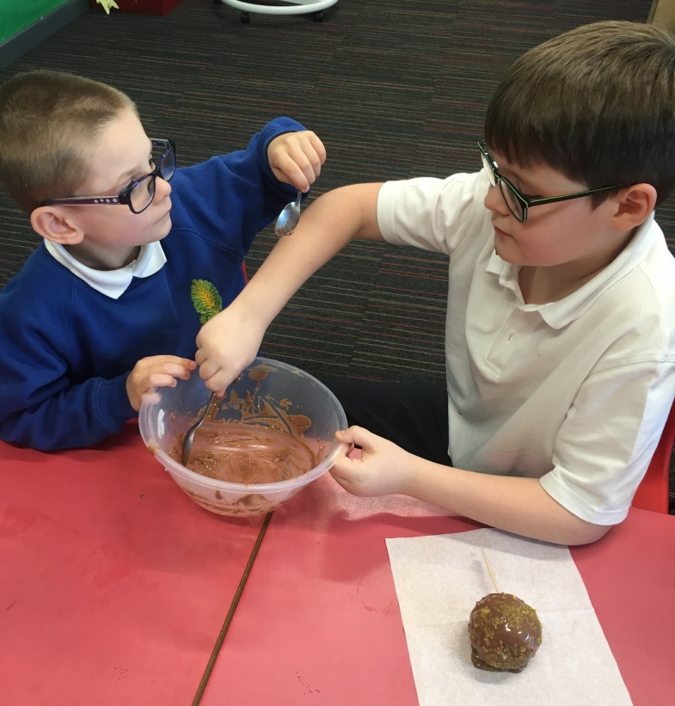
We picked apples on the school grounds, covered them in chocolate and sold them to raise money for the Rainforest Room.

Slide 20
Partnership with Parents/Carers
Parental support is vital to a child’s progress and we recognise the importance of involving parents/carers in their child’s education. Together we explore how best to meet your child’s needs. Parents/carers are invited into the Nurture Room on a termly basis to see what their children have been doing and join in some activities. Parents/carers also receive regular updates on their child’s progress and consulted about their child’s return to class on a full-time basis.

Slide 21
Feedback from the children
I am much calmer and I’m able concentrate more in class.
My listening is getting better in class.
I’m not as quiet and talk more in class.
My reading and writing has got better.
My behaviour has improved.
I find it easier to make friends.

Slide 22
Please contact the school if you have any questions or queries regarding the Rainforest Room

